Slide 1
IT 5431 - Essentials of Artificial Intelligence Blackboard version
Prof. Asoka S Karunananda
Senior Professor
Department of Computational Mathematics
MSc AI B18
1
19/07/2025
‹#›

Slide 2
Structure of the Lecture series
Topic 1 - Foundation of AI (12 hrs)
Topic 2 – Search (12 hrs) - Transformer
Topic 3 - Knowledge Representation (12 hrs) - LLM
Topic 4 – Major areas of AI (4 hrs) – covered in Topic 1
‹#›

Slide 3
Preamble
One should learn a subject, first by knowing about the subject (Math and Science?)
What AI is about:
AI is about understanding intelligence and building intelligence into machines
AI is about understanding intelligence and constructing intelligent machines
AI is about the science (understanding) and engineering (construction) of building intelligent machines
AI strives to understand intelligence and program intelligence into machines
Need a transformation in the way we learn
BSc - Prepare for set questions
MSc 🡪 capacity to give answers
Na + Cl 🡪 NaCl
P+A 🡪
‹#›

Slide 4
Preamble
Secondary education – Learning a subject
Tertiary education – Apply/Extend the subject (Research)
Understanding is a fundamental concept in learning
Prior knowledge + New knowledge + Thinking 🡪 Understanding
Issues with understanding
Reading comprehension (at exams)
Inability to pick important points
Taking own notes gives multiple benefits
Build the ability to pick the points
A Note is a cognitive device for memory and thinking
Everything may not be understood during a lecture
275*38 =
‹#›

Slide 5
Preamble
Einstein – The purpose of education is to build students with the capacity to think
Thinking produces almost all cognitive skills
Intelligence, Memory, understanding, creativity, visualizing, problem-solving, reasoning,
The field of Artificial Intelligence is central to the concept of intelligence (natural)
Therefore, the AI community should be curious about thinking
‹#›

Slide 6
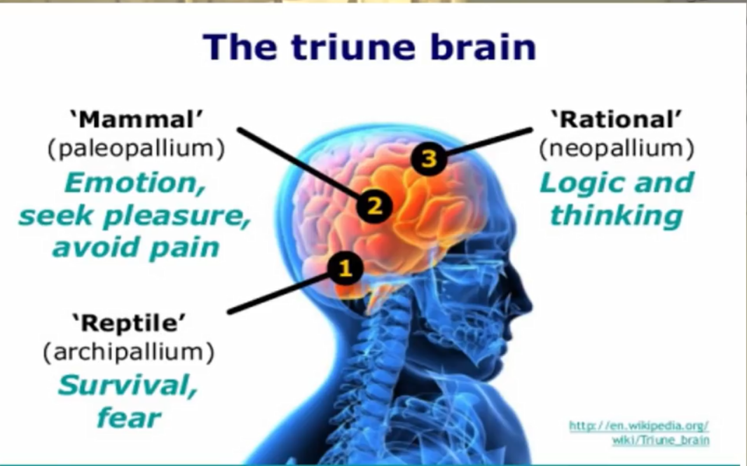
Preamble
‹#›

Slide 7
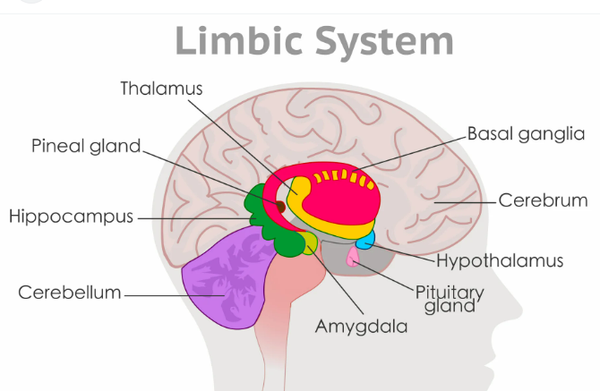
Hippocampus
Memory formation and access
Regulate: temperature,
hunger, thirst, sleep, mood
fear
Hippocampus forms long term memories

Slide 8
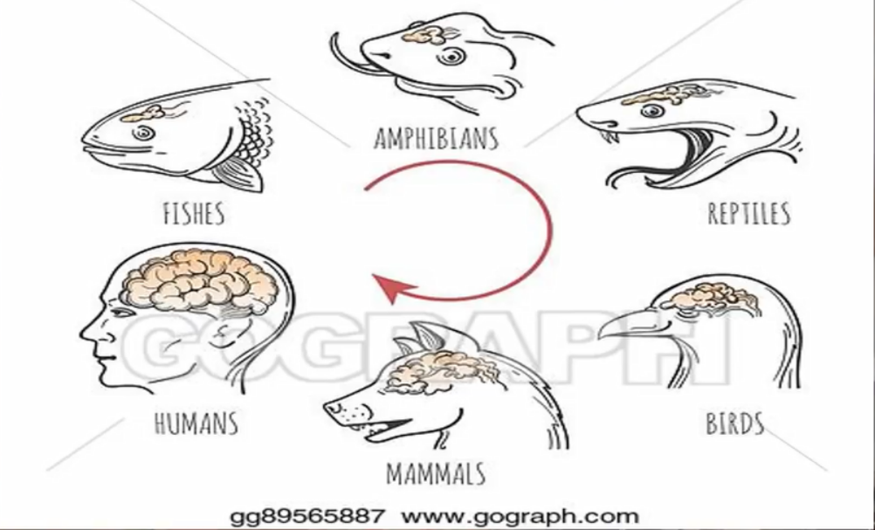
Evolution of the brain

Slide 9
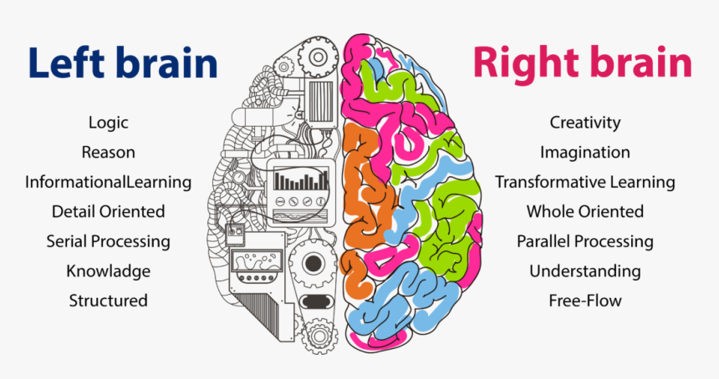
Two ways of Intelligence
Language (NLP)
Games
Deep Blue (L)
AlphaGo (R)
Robots
2x3 = 6 (R)
375x97 = …… (L)
20B/100B
Logica/analytical
Symbolic (ACS)
Algorithmic
Formal
Knowledge
Training (ML)
Non-Symbolic
Non-Algorithmic
Informal
Data
‹#›

Slide 10
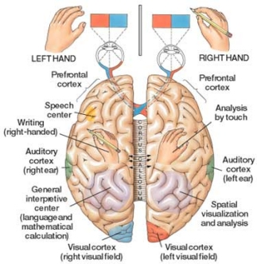
ES
ANN
Mindful walking
Distinguish Left/right (L)
sensation - heat/softness (R)
‹#›
Notes:
‹#›

Slide 11
Topic 1 – Foundation of AI
‹#›

Slide 12
Foundation of AI
Introduction (General, Academia, Industry)
Intelligent machines – a dream or reality?
Influential areas for AI
Major Areas of AI
Turing Test
John Searle’s argument
Four Schools of Thought
History of AI
State of the art
Agent Technology
‹#›

Slide 13
Exercise 1
What does AI do?
AI builds intelligent machines
Machines can also evolve (Arthur Samuel) from manual to intelligent
Intelligent machines are a result of the evolution of manual machines
We are in the Age of Intelligent Machines
How does AI build/construct intelligent machines?
AI programs natural intelligence into a machine
We can develop an intelligent fan
Program the tasks that require human intervention
When hot, increase fan speed. No people, switch off the fan, more people, swing the fan
The idea of intelligence can be
programmed to a machine
was presented by Turing
(1952)
Read, write, left, right, delete,
do nothing.
Paper making -
‹#›

Slide 14
References
Russell and Norvig (2020), Artificial Intelligence – a Modern Approach, 4th Edition
UMBC Agent
Carnegie Mellon University (First Faculty of AI, First BSc Hons in AI)
‹#›

Slide 15
Introduction - General
AI is the most cited buzzword in the modern world
AI is the Science and Engineering of building Intelligent Machines
S, E, both, distinct area? (four-fold logic)
Can you understand NaCl by knowing the features of Na and Cl separately?
AI strives to understand natural intelligence (science) and build intelligent machines (engineering)
AI does not talk of machine-generated artificial (කෘතිම) forms of intelligence
AI has gone into all sectors (health, agriculture, transportation, online marketing, war) of society
Nowadays, people cannot live without AI (facing the competition)
AI has revolutionized academia and industry
Notes:
‹#›

Slide 16
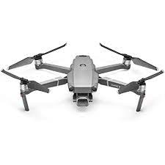
Introduction - General
AI
memory
AI is the fuel for the 4th industrial revolution (modern machines are powered by AI programs)
steam, electricity, electronics, AI (programs/algorithms)
AI has changed how people do things everywhere
Home - cleaning, WM, CCTV, engineering,
Health – disease diagnosis, online
Will AI lead to technological singularity (supersedes humanity?)
People promoted Machine Learning but forgot Human Learning
Knowledge (money, weapons, lands, technologies) is the power
AI outperforms humans when humans face biological limitations
efficiency, accuracy, high access/reaction timeline, exploring an unknown environment, dealing with many parameters, reaching inaccessible locations
input
Process
output
Power
If one propeller is broken
What are the possible solutions?
Repairer (mechanical/electrical)
Replace
Program propellers to maintain
The balance
‹#›

Slide 17
Exercise 2
Identify the situations where machines are better than humans.
high access time for the available knowledge (exam)
High reaction time when generating an answer (calculations)
Dealing with a large number of parameters (flight scheduling)
Decision-making in changing situations (Pandemic)
Exploring unknown environments (underground, seabed, space)
Exploiting hazardous, unreachable situations (fire, radiation)
Working in Emotional, disastrous, etc. situations
‹#›

Slide 18
Introduction - Academic
AI is the subject to program natural intelligence into machines
AI solves problems that could not be solved otherwise
AI can use knowledge or data for problem-solving
AI can model solutions even with less or zero data/knowledge
AI can solve both algorithmic and non-algorithmic systems
Neuroscience provides a strong basis for AI
Logical/analytical-based intelligence (symbolic AI) – left brain
Training-based intelligence (non-symbolic AI) – right brain
1950s - AI is a module within Computer Science degrees
20xx – MSc in AI – two-year part time
2010 - AI specialization (2+2) in CS degree (Edinburgh, UK)
2018 - BSc 4 degrees in AI (CMU-2018, UoM-2021)
203x - Specializations in ML, NLP within AI degree
X+Y = 3
2X+2Y = 5
No mathematical solution,
But AI can find reasonable
X=1. y=1 Er =1, Er=1
X=0, Y=1 Er= 2 Er=3
‹#›

Slide 19
Introduction - Industry
AI implements how humans/animals (natural) solve problems
As a model of the human brain, AI can solve any problem
AI can solve a problem in more than one way like humans
AI can generate evolvable solutions (accurate/efficient)
AI solutions are extensible
AI solutions can be built on existing systems (DB, ERP, MIS, Web)
AI can give not only answers but also reasons (ES)
AI can give answers very quickly (time-critical applications)
AI can handle many parameters at one time
AI can work on incomplete, noisy, dynamic data/knowledge
‹#›

Slide 20
Exercise 3
Explain why humans need a higher reaction time than cobras.
Humans deal with so many sensory inputs to make decisions, where lots of information processing is involved. But cobras mainly use only smell
Cobra has developed processing of its single sensory input.
‹#›

Slide 21
Introduction - Enthusiasm for AI
AI had a hard time for 35 years – development was invisible, no recognition
Many programs gave popularity to AI
XCON (1989) – Expert System (ES) - gave industry recognition for AI
accuracy, efficiency, (symbolic AI)
DART (1991) – Expert system (ES), which did the entire Gulf War
Real-time, large no. entities (50,000), accuracy (pinpoint)
Pathfinder (1997) – Exploring Mars
Working in an unknown environment, real-time,
Deep Blue (1996) - Grandmaster of chess Kasparov, was defeated
multiple options (25-35), best move, many steps ahead, efficiency
Watson (2011) – large expert systems
Versatility, use symbolic and non-symbolic (ML) approaches
AlphaGo (2015) – ML-based solution
Millions of options, accuracy, efficiency,
Self-driving cars (2009) –
Autonomy, adaptability, real-time (efficiency)
2
26/07/2025

Slide 22
Introduction - Enthusiasm for AI ..
Many programs gave popularity to AI ….
Tesla (2015) – Unmanned Truck
Sophia (2016) – Versatile humanoid robot
First to get citizenship
Amazon Alexa - home automation
Google Assistant – Chatbot (static information)
Neuralink – a device for sending electrical signals to the brain
ChatGPT – predicting the next word
Agentic AI -
Future of AI – the gap between man and machine will be reduced
2 + 1/3 + 1/7
Addition
Multiplication
Fraction
‹#›

Slide 23


Nature of Knowledge and AI
Different subjects promote different ways of thinking (mindset)
Science – experiments, a large no. of evidence, explain (know why)
Mathematics – measurements/calculation/patterns
Algebra - √2 = 1.414 Geometry
1/3 = 0.3333,
Engineering – apply science
(shape, color, cost, weight, durability, appearance, efficiency)
Technology - know-how (even without a science)
Technology comes before science (old kaum and penicillin)
Many devices are technological advancements and still use science discovered in the 17th century (F=ma, V=IR)
Formal knowledge – subjects with theories, models, algorithms, etc.
Informal knowledge - commonsense, belief, trial and error, etc.
Where is AI? – AI can use both like human
-3*-4 = -12 98%
-3*-4 = 12 2%
Mathematical theories cannot be proven by science/experiments
1
√2
1
‹#›
Notes:
‹#›

Slide 24
AI Dream or reality?
Discovery of artifacts by mankind
Early days to make physical activities easy
E.g. various tools, wheels, etc.
Artifact to Make ease of Intellectual activities is a quite natural interest
Ruler, calculator are some examples
Simple machine using pulley and strings
Video – Familiarizing with machine intelligence
‹#›

Slide 25
Simple machine to multiply by 2
2
B
A

Slide 26
Exercise 4
Identify the intelligent features that are already built into machines.
Language understanding
Avoiding obstacles
Maintaining balance
Distance by Seeing
Hearing
Walking
Swimming
Decision making
Planning
memorizing
……..
‹#›

Slide 27
Why AI is so different?
Why is AI different from other technologies?
Since power and control are together, AI can
+ve: build autonomous solutions: self-driving vehicle,
drones, chatbots, customer care,
-ve: AI can supersede humanity
to avoid AI superseding humanity, there are initiatives: human-centered AI, Responsible AI, and Explainable AI
 | Power | Control
Electricity | Technology | Man
Automobile | Technology | Man
Steam engine | Technology | Man
Nuclear energy | Technology | Man
AI | Technology | Technology
‹#›

Slide 28
Exercise 5
Which of the following machines are intelligent? Justify your answer.
Computer (No – it can be programmed to be intelligent)
Self-driving car (Yes – without a human, it can drive)
Motorcycle (No – no way to program either)
Abacus (No – it can help humans to do intelligent tasks)
Calculator (Yes – without human calculation can be done)
Smart camera (Yes – motion tracking, …….)
‹#›

Slide 29
Foundations of AI – Influential areas
What are AI-related philosophical
Concepts?
Thinking
Intelligence
Ethics
Knowledge
Reasoning
Computability
Intelligent machines
Philosophy (428BC) – change the direction of thinking
real/simulation, mind/matter, intelligent machines, intelligence, Knowledge, consciousness, thinking, man/machine, computability
Mathematics and Statistics (800)
formalizing our symbolic system (F=ma), the logic for reasoning,
algorithms
computability (Turing-1939: read/write/left/right/delete/do nothing)
Economics (1776-) - resources, profit, cost
Neuroscience (1861-) - the foundation for defining 2 forms of intelligence as analytical and training
Psychology (1887-) – Mental Health (anxiety, depression, ELIZA) very first AI program (NLP) - dialog between a psychiatric patient and a doctor
‹#›

Slide 30
Foundations of AI – Influential areas
Computer Science
To program the intelligence into machines (Turing)
Programming languages, data structures, algorithms, OS, compilers
Computer engineering (1940 -)
Constructing a machine to run the programs
Control theory and Cybernetics (1984-) – control and networking
Linguistics (1957-) – science of languages (NLP), LLM
Other sciences like
Education (teaching/learning)
Physics, Biology, and medicine
‹#›

Slide 31
Exercise
What is the most influential area for AI to build intelligent machines in their current form? Justify your answer.
Mathematics. We develop intelligent machines by computerizing natural intelligence. Computability, algorithms are a concept of mathematics
What is the most influential area for defining a theoretical basis for AI to construct intelligent machines? Justify your answer.
Neuroscience – Neuroscience has identified two forms of intelligence: analytical-based and training-based. Left and right
‹#›

Slide 32
Foundations of AI
Parallel computing (ANN)
Distributed computing (MAS)
Education
Computer Science
In the modern world
AI contributed to R&D
In all disciplines.
Neuroscience
Computer Engineering
Linguistics
Foundations of Artificial Intelligence
Psychology
Economics
Cybernetics
Mathematics and Statistics
Natural Sciences
Philosophy
Control Theory
‹#›

Slide 33
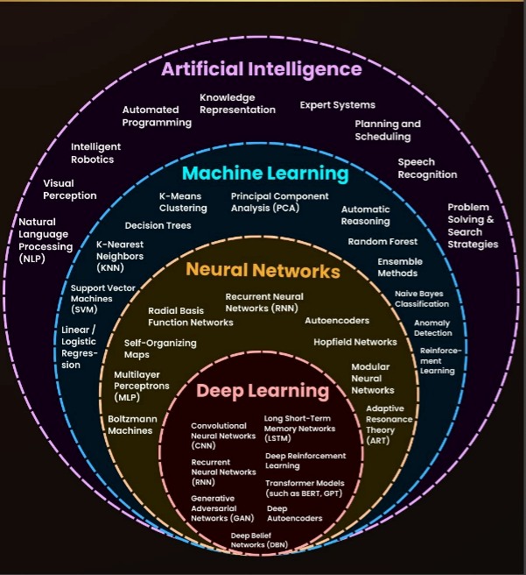
‹#›

Slide 34
Major Areas of AI
All AI technologies can be classified under
symbolic AI(Artificial Cognitive Systems – rules/theories/knowledge/algorithmic- analytical)
non-symbolic AI (Machine Learning – data/non-algorithmic-training)
Artificial Cognitive systems (ACS) – symbolic (raw material is knowledge)
Expert systems, Natural Language processing
Multi Agents Systems, Game playing
Fuzzy Logic, Ontology
Machine Learning (ML) – non-symbolic (raw material is data)
Artificial Neural Networks, Deep Learning, Genetic Algorithms
Robotics, Computer Vision
Some areas can come under both
Game playing (Deep Blue – S, AlphaGo - NS),
Natural language processing (Eliza – S, Google Assistant - NS), Robotics(Sharkey – S , Alexa - NS)
‹#›

Slide 35
AI and Machine Learning
ARTIFICIAL INTELLIGENCE
-build intelligent machines-
Machine Learning
-statistical and mathematical data analyze
Deep Learning
-based on a model of the brain –
artificial neural networks
‹#›

Slide 36



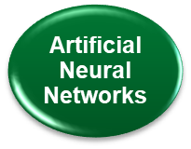
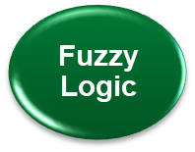

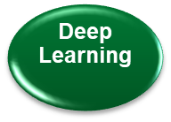


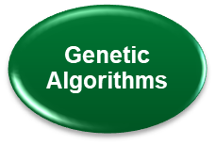

Major Areas of AI
Artificial Intelligence
Artificial Cognitive Systems
Machine Learning
‹#›

Slide 37
Change in naming the subareas
Artificial Intelligence (gives a sense of machine-made intelligence) – suggested terms: Computational Intelligence, Intelligent Systems, Intelligent Machines (බුද්ධිමය යන්ත්‍ර -- බුද්ධිමය යාන්ත්‍ර විද්‍යාව)
Artificial Cognitive Systems
Artificial Neural Networks
Natural Language Processing
Expert Systems
Robotics
Multi Agent Systems
Machine Learning
Computer Vision
Ontology
Deep learning
3
02/08/2025
‹#›

Slide 38
Homework
Compile a video on chronology of development of AI
‹#›

Slide 39
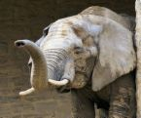

Inspiration to Theory
Teeth inspire a wedge
F/A = Pressure

Slide 40

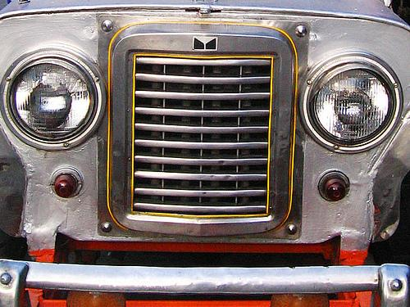
Nature and Artifacts

Slide 41




Slide 42



Slide 43
Grid (+/-)
Collector
+
-
Emitter
Collector
Base
Based on the current applied to the base the flow of
current through emitter-collection junction can be controlled
Emitter

Slide 44
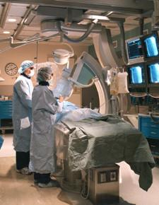
Expert Systems
Problem solving knowledge
Inspiration for ES comes from
Problem-solving by human experts that
consider separately
Subject/domain knowledge
Problem-solving knowledge
Features of ES (doctor and patient)
1. The doctor dominates asking questions
2. Deal with incomplete information
(asking question, assume, ignore)
3. Give answers
4. Give reasons/explanations for the answer
5. Give alternative answers
6. Tell the level of assurance
ES is the champion of the symbolic-AI
(ACS) approach to AI
Domain specific knowledge

Slide 45
Exercises
Identify areas where ES can be used.
(any area dealing with Incomplete information, Alternative solution, Assurance of answers, Answer with Explanations
Medicine, Banking, Tourism, manufacturing, Agriculture, counselling, design,
Identify areas where ES is not suitable/required
Arithmetic calculation, searching a book in a library catalog,
‹#›

Slide 46
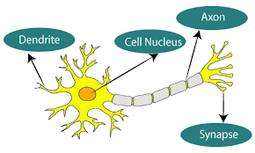
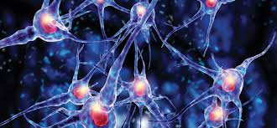
Artificial Neural Networks
ML
1943 –ANN
1962 – stop (Minsky)
1986 - BP
2000 – Deep Learning
2015 – Transformers
………
Expert and Technician
ES ML
How many tiles are required
This floor?
Inspiration comes from the human brain with neurons (CPU) and connections (memory)
ANN is the very first (1943) intelligent program
ANN implements learning by training as an intelligent feature
ANN learns from data which are incomplete, noisy,
partial, dynamic, unstructured, non-algorithmic
ANN is the champion of non-symbolic AI (ML)
ANN requires lots of data for building a solution
ANN is good for identification, classification,
generalization, generation/construction,
forecasting, predictions, pattern/trend recognition,
abstraction (data mining)
This is the fastest AI technology in decision-making. Why? – training-based

Slide 47
N P K Ca Mg, Zn, Cu Yield
5 3 1 1 2 3 20
2 3 1 0 2 4 15
3 2 2 1 1 3 18
8 8 1 1 1 2 20
Train the ANN for these data, then ask
a query like what would be the yield
If I use the following ratios.
2 1 3 1 1 3 ?
‹#›

Slide 48
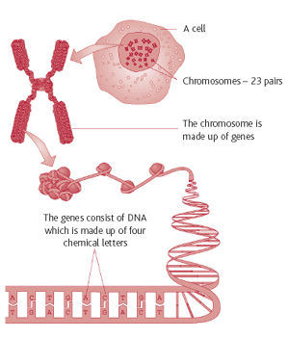
Inspiration comes from chromosomes and genes in biological systems
Biologists identified three genetic operations:
cloning (copy), mutation (invert), cross-over (swap). These operations can produce new chromosomes (solution)
Bread Dhal Orange Milk - 600
Rice Chicken Yogurt Tea - 500
Swapping over the 2nd gene gets 2 solutions
Bread Chicken Orange Milk - 700
Rice Dhal Yogurt Tea - 400
Which one survives better – fitness function
GA generates – solutions similar to parents
quite different from parents
from zero data (initialize with random data)
model dynamic situation (traffic)
GA is also an ML technique that use data
GA is for design, optimization, scheduling, adaptive solutions
Parents produce children
with similar features to parents
(cross-over)
different from parents’ mutation)
Data trained into
Network (ANN)
1-dimensional array (GA)
Tree (DT)
Genetic Algorithm (evolution)

Slide 49
Arm Legs Seat Back Hand
Steel steel wood plastic wood
Wood wood wood wood wood
Steel wood cusion wood plastic
Result of cross-over between 1st and 2nd chromosome
through the 2nd gene
Steel wood wood plastic wood
Wood steel wood wood wood
Cross-over – get children with similar features to parents
Mutation – get children with somewhat different features to parents
Bread Bun Crocodile bun fish bun profit (>400)
25 25 30 500
20 25 25 450
20 20 30 600
75 30 20 10 300
GA can model ML solution even without/less initial data.
‹#›

Slide 50

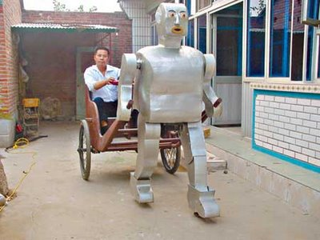
Inspiration for Robotics comes from mobility
of humans and animals
Smart sensing (vision, auditory, touch, heat)
Actions like walking, climbing, operations
Implement as both symbolic/non-symbolic AI
Robotics

Slide 51


Multi-Agent Systems (Agentic AI)
Inspired by Problem-solving
by teamwork
Inspiration comes from ants,
bees, birds, fish, elephants,
Task force for COVID
Organizing a shramadana
Group assignments
MAS can come up with a solution
even from zero knowledge at
the beginning (group assignment)
2. MAS can generate better solutions
than individual one
1 (individual)+ 1 (individual) < 2 (collective)
3. MAS uses message passing rather than
Algorithms to solve problems?
MAS can produce innovative, efficient, high-quality solutions beyond individual
capacity
One person 20 bricks per hour
According to MAS - How many bricks will be
Completed in one hour by two persons?
40 40> 40<
AI Agents

Slide 52
Fuzzy Logic
Not being exact is also an intelligent feature
The world is full of situations where a conclusion does not fall into one end but a set of acceptable values in between.
Adding salt into a curry (10ml) (9.8ml-10.4ml)
Function of a thermostat of an AC (18C) (17.5-19.2)
Automatic focusing of a camera (4m) (3.8-4.3m)
Weight-based spins of a washing machine (5kg) (4.8kg – 5.2kg)
Applying break and stop a vehicle
FL is suitable for controlling applications – vehicles, inventories, dropping, navigation,…..
FL can be primarily implemented as ACS/ML solutions
‹#›

Slide 53
Exercise 5
Discuss what actions of the watering robot shown in the video may use fuzzy logic
Amount of water
Distance from the plant
Moisture level of soil
Water pressure
‹#›

Slide 54
Natural Language Processing
McCarthy CMU MIT Stanford (ES)
Minskey MIT MIT MIT (NLP)
NLP implements the intelligent feature of communication
It includes many related intelligent features
Understanding
Dealing with incomplete sentences
Translation among languages
Converting speech to text
Generating/synthesizing an answer
There are 10 balls in box A and 12 balls in box B. Saman has taken 3 balls from A
and he kept two with him and the remainder is added to A. Find how many balls
now in the box A.
Today ChatGPT (Large Language Models) can answer this
Since ELIZA, NLP has evolved from symbolic AI to ML
‹#›

Slide 55
Exercise 6
Explain why NLP could be implemented as a symbolic and non-symbolic solution (think whether humans can do it)
We can handle languages by knowing grammar and/or by training without knowledge of grammar (tourist guide)
Other areas with both symbolic/non-symbolic modelling
Robots can work based on rules (Unimate) or training (Atlas)
Games can be played by training (AlphaGo) or knowing rules (Deep Blue)
‹#›

Slide 56
Gamming
Gaming is an intelligent activity requiring recognizing many options at a given state and deciding the best option
This can be done knowing rules (ACS), or using data generated in games (ML)
Chess has 25-35 moves; so rules (ACS) can be written
Go has 2.1x10^170 moves, so only ML is possible
4
09/08/2025
‹#›

Slide 57
Concerns about developing AI solutions
Program Learning
Outcome (PLO) of the degree
Ability to communicate
AI solutions to clients,
Customers, professionals,
Society at large
Note: Humans can solve any problem (thinking-brain and training-brain). Therefore, AI can also solve any problem
AI can solve a problem (game/NLP) in more than one way (ACS and/or ML) and give more than one answer
Taking AI solutions to industry (Production AI) is challenging
Nature of raw material for AI (knowledge/data) in the domain
Algorithmic/non-algorithmic
Formal/informal, noisy, incomplete, dynamic
Availability of Knowledge (acts, bills, ….)/Data (Me, Agri, )
Symbolic solutions/non-symbolic solutions
Alternative solutions, explanations, certainty of answers, incomplete, noisy, dynamic data/knowledge
‹#›
Notes:
‹#›

Slide 58
Concerns about developing…
Choice of Technologies
Symbolic - (ES, MAS, FL, NLP, Ontology, Robotics)
Non-symbolic - (ANN/ML, GA, NLP, Robotics)
Extending existing digital solutions:
Addressing biological limitations: reaction time, access time, accuracy, number of parameters (Deep Blue), inaccessible environment (Drones), unexplored situations (Path Finder), changing parameters, fatigue
New concerns: explainability, singularity, LLM, localized LLM (RAG), AI Agent
A graduate should be able to communicate about AI solutions to the client, industry, and society at large.
‹#›

Slide 59
Exercise 7
Discuss how you decide the kind of AI solution required for an organization
Where human involvement is extensive
‹#›

Slide 60
Exercise 8
Would all symbolic AI solutions be able to give explanations?
NO-
ES, MAS, FL, Chatbot (ELIZA), Game(Deep Blue), Ontology, NLP (starts in Symbolic, and evolves towards non-symbolic)
‹#›

Slide 61
The Turing Test
Now we are interested in how we decide whether a machine is intelligent.
TT is an approach to test whether a machine is intelligent (“Computing Machinery and Intelligence” – 1952)
A man and a woman communicate with an interrogator without seeing each other
Man is replaced with a machine without knowing the interrogator and he continues questioning
If the interrogator cannot notice a difference between answers provided by the woman and the machine, then the woman and the Machine are equally intelligent (If the machine can fool the interrogator, then the machine is intelligent) - if a student is less knowledgeable ChatGPT can fool the student
‹#›

Slide 62
Note
A major concern of ChatGPT-like ML solutions (the machine can fool the interrogator) was acknowledged by Turing 75 years ago.
The paper title “Computing machinery and intelligence” indicates that Turing realized that intelligence could be programmed into a computer.
‹#›

Slide 63





The Turing Test
X
Asking questions
‹#›

Slide 64

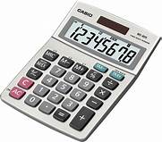
The Turing Test
TT to show the calculator is intelligent
MS-Word
Modify the TT to show that the baby is
Intelligent
Ask the baby and the machine to
to react to a song
Sqrt(345)?
‹#›

Slide 65
Exercise 8
Construct a Turing Test to show that MS Word is an intelligent machine
MS-Word (task – checking spelling)
With whom MS Word is compared (a non-native English child/ native English baby of age 3))
MS-Word (task – rephrasing a paragraph)
With whom MS Word is compared (Prof. English)
‹#›

Slide 66
Implications – The Turing Test
Intelligence is measured comparatively
Can be used to prove that a machine is intelligent, or that a machine is not intelligent
The test depends on the level of
difficulty of the question being asked
intelligence of the interrogator (Turing said that if the machine can fool the interrogator, then the machine is intelligent)
intelligence of the person with whom the machine is compared
Task and with whom compared
‹#›

Slide 67
Technological limitations for TT
The standard Turing test was limited to asking text-based keyboard entry
The “Total Turing Test” has been improved with
NLP capacity to communicate in plain English
Knowledge representation to store knowledge
Automated reasoning to store knowledge, answer questions, and draw conclusions
Machine learning to adapt to learn from the past unstructured data
Computer vision (capturing and processing images
Image processing (moving/still images)
‹#›

Slide 68
Turing Test Competition
Loebner Prize
The Loebner Prize is an annual competition that awards prizes to software that could pass the Turing Test
ALICE is the first intelligent software to pass the TT (1995)
In 2019, Mitsuko won the Loebner Prize for 4th consecutive year
Find the LP winning software during the last 5 years?
‹#›

Slide 69
Exercise 9
Read about the Loebner Prize
Can TT be used to decide on the intelligence of both symbolic and non-symbolic AI solutions? Justify your answer.
Yes – both Deep Blue and AlphaGo defeated humans
“All Intelligent programs have passed the TT” Do you agree with the statement? Justify your answer.
Should a program pass the TT to claim that it is intelligent?
No – XCON, ELIZA, DART, they have implemented an intelligent feature, but they did not pass the TT.
‹#›

Slide 70
John Searle’s Chinese room argument
John says that Intelligence requires awareness/consciousness
So, a machine is intelligent only if it knows what it does
A person who knows neither English nor Chinese is kept in a room with a huge book containing the Chinese translation for any given English phrase, in adjacent pages
A person can find the correct translation just by manipulating symbols, without being aware of what the symbols mean
Therefore, we may say that man is not intelligent
On the same token he says, machines can also do symbolic manipulation and give answers, without knowing the meaning of symbols, therefore machines can/cannot be intelligent.
‹#›

Slide 71
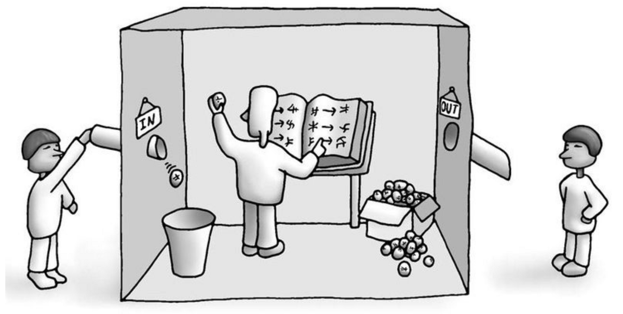
Chinese room
‹#›

Slide 72
Implications – Chinese room argument
Machine can never be intelligent
Should we really bother about whether a submarine can swim when it behaves as if it can swim?
If a cat can catch rats, should we really bother whether the cat is real or a clay cat
Should we ask a student whether you use left brain, when he has secured a grade A for mathematics?
TT – Intelligence is not eternal, but
depends on the task/person
JS – intelligence requires awareness
‹#›

Slide 73
Exercise 10
“Unless a program has passed the Turing Test it cannot be considered an intelligent program.” Do you agree with this statement? Justify your answer.
Wrong – passing TT is an additional qualification
‹#›

Slide 74
Exercise 11
If you want to show that Atlas is intelligent, explain how you set the TT.
Task
Explaining an unknown environment
Explaining the environment with obstacles
If someone criticizes the TT, what is the best counterargument to support the TT?
If TT is wrong, we cannot use exams to judge students
‹#›

Slide 75
Four schools of thought of AI
NO exact definition for intelligence or the role of AI
Is this a strength/ weakness point of AI?
Atom has 3 different views
Dolton (an atom cannot break)
Einstein (break and generate nuclear energy)
Schrodinger (uncertainty/quantum computer)
During Buddha’s time - 62 views on life/death
Everything is a conditional phenomenon (හේතු/ඵල) there is no god like a doer
AI also has 4 views on Intelligent machines
‹#›

Slide 76
Four schools of thought of AI
Acting humanly (ES)
According to this view AI attempts to build machines that can behave like humans. This is the TT approach
Thinking humanly (Deep Blue)
… machines that can think like humans.
Thinking Rationally (Decision making)
…machines that can think logically.
Acting rationally (doing the right thing)
Doing the right thing. The new approach to AI
‹#›

Slide 77
Acting Humanly
According to this view, AI attempts to build machines that can behave like humans. This is the TT approach
This is the oldest view of AI, and even ordinary people accept this view
Expert Systems, NLP, and Game Player, Problem Solvers are examples.
But this view does not promote the value of animal intelligence (Boston Dynamics) to build intelligent machines.
‹#›

Slide 78

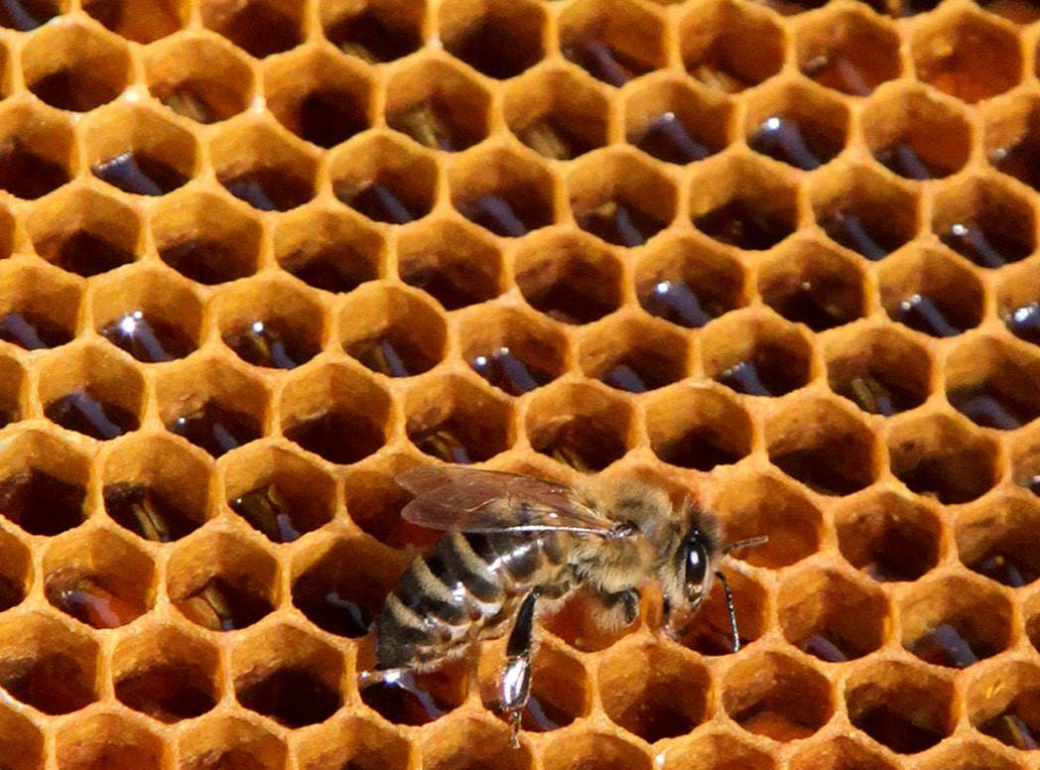
Animal Intelligence?
V-top>V-bot
🡪 P-top<P-bot
then what?
Air flows from the bottom
to the top. cold
V-top
V-bot
‹#›

Slide 79
Thinking Humanly
According to this view AI attempts to build machines that can think (මනසිකාර) like humans
Present knowledge + Past knowledge + Thinking 🡪 understanding
This requires theories from cognitive science
Although we don’t know what thinking is, we know tasks involving thinking
Problem-solving
Game playing
Theorem proving
There are already problem solvers (GPS), and games (Deep Blue, AlphaGo) come under this school. This school is possible.
Since thinking is done with awareness, game players like programs disprove John Searle’s Chinese room argument
/‹#›

Slide 80
Thinking Rationally
Thinking rationally means, thinking logically.
Many symbolic programs use Logic
Expert systems, NLP, Robotics, Games
But all knowledge in the world is not logical
Logic also has misleading ideas
Consider the rule P🡪Q, Q🡪R, concludes P🡪R
If the baby is dead (P), then the baby does not cry (Q).
If the baby does not cry(Q), then the mother is happy (R).
It concludes: If the baby is dead, then the mother is happy
‹#›

Slide 81
Acting Rationally
According to this view AI wants to develop machines that can do the right thing
Here “the right” means
More practical, doable, and less costly, etc… …..
When a building is on fire you disregard behaving like a human, think like a human, or logically instead break the windows as the right thing and jump
Building the machines to do the right thing is considered a modern approach to AI
5
16/08/2025
‹#›

Slide 82
Definitions for AI
Acting Humanly
The art of creating machines that perform functions that require intelligence when performed by people (Kurzweil, 1990)
The study of how to make computers do things at which, at the moment, people are better (Rich & Knight, 1991)
Thinking humanly
The exciting new effort to make computers think ……machines with minds, in the full and literal sense (Haugeland, 1985)
Automation of activities that we associate with human thinking, activities such as decision-making, problem-solving, and learning (Bellman, 1978)
‹#›

Slide 83
Definitions for AI….
The study of mental faculties through the use of computational models (Charniak and McDermott, 1985)
The study of computations that make it possible to perceive, reason and act (Winston, 1992)
Computational Intelligence is the study of the design of intelligent agents (Poole et al, 1998)
AI is concerned with the intelligent behaviour in artifacts (Nilsson, 1998)
‹#›

Slide 84
Exercise 11
Giving an example, describe why we could consider an AI program more than under one school of thought.
Deep Blue can be considered as Acting humanly: because it has defeated a human being. That means it was able to prove that it can behave like a human.
Deep Blue can be considered as Thinking humanly, it shows the ability to play a game, which requires thinking.
Thinking rationally (logical) – symbolic AI programs are written using logic
Deep Blue can be considered as acting rationally (doing the right thing); because Deep Blue can find the best option out of options available
Can Alphago consider
under acting humanly
Yes
Cannot be consider
under thinking rationally – no symbolic logic
Used for decision-making
‹#›

Slide 85
Exercise 12
Discuss TT and JS arguments under four schools of thought.
TT-acting humanly
JS- does not fall under any school
‹#›

Slide 86
History (developments) of AI -how change has happened-
The Gestation of AI (1943-1955)
After World War 2 lot of enthusiasm to discover knowledge
Curiosity about constructing intelligent machines
In 1936, Turing developed the Turing Machine to demonstrate computability (using paper and pencil)
Six primitives: Read, write, left, right, erase, do nothing can computerize anything
In 1943, Turing decoded Enigma using the machine Bombe
In 1943, McCulloch & Pitts ANN (model of the human brain)
In 1945 Von-Neumann proposed the FDE cycle on CPU and Memory
In 1948, the transistor was invented, the digital computer was born (George Boole, 1870)
In the 1950s, John McCarthy and Minsky completed their Ph.D. at Princeton (Turing, Einstein) University Mathematics Dept.
McCarthy joined Carnegie Mellon (CMU); Minsky joined MIT
Turing’s (1950) seminal paper “Computing Machinery and Intelligence”
A computer can be programmed for intelligent tasks
The Turing Test is in the above paper
Memory (data, Instruction)
CPU
‹#›

Slide 87
History of AI
The birth of AI (1956)
At the Dartmouth conference (10 attendees - MIT, Stanford, CMU, IBM) – McCarthy proposed a distinct subject for intelligent machines
McCarthy coined the name Artificial Intelligence to refer to the area of Intelligent machines
McCarthy defined AI as the science (understanding) and engineering (construction) of building intelligent machines.
Synonyms for AI - Intelligent Systems, Computational Intelligence, and Intelligent Machines. Why?
The idea came from Turing to program intelligence into computers
McCarthy joined MIT (where Minsky was) and then to Stanford
McCarthy - Intelligent is logic-based (symbolic)
Minsky - intelligent is anti-logic based (symbolic)
Early development of symbolic AI (ES) started at Stanford and CMU
MIT also promoted NLP and Robotics
US Defense Ministry funded AI initiatives under DARPA
Author Samuel (1959) showed that if a computer does something repeatedly, it improves performance (Machine Learning)
‹#›

Slide 88
History of AI
Early enthusiasm (1952-1969)
Early AI systems were very much algorithmic/logic-based
General Problem solver (CMU 🡪 MIT 🡪 Stanford)
Game playing (CMU🡪IBM – Deep Blue)
Theorem provers (IBM)
Note: AI talks of both algorithmic and non-algorithmic approaches because neuroscience identifies left-brain/logical, right-brain/training
In the Early 1960s, Minsky Criticized ANN saying it was useless
People gave up research in ANN for nearly 25 years
People continue to maintain an interest in what intelligence is
Search was recognized as the 1st approach to model intelligence
Because search is a well-known task requiring intelligence
It is the well-known method of drawing conclusions
Prof. Rumelhart
McClelland (1986) - BP
Jefry Hinton (2000)
-Deep Learning
‹#›

Slide 89
History of AI…. Intelligence 🡪 Knowledge 🡪 Data 🡪 EEG
Knowledge Based systems (1969-1979)
People realized knowledge as the main ingredient of intelligence
Knowledge is everywhere: learning, books, papers
Modelling knowledge instead of intelligence is very practical to build intelligent machines (Allan Newell- CMU)
Area of Knowledge representation came as the 2nd approach to AI
Under knowledge modeling, many symbolic AI programs were developed
Natural Language Processing (ELIZA – first chatbot by MIT 1964)
http://psych.fullerton.edu/mbirnbaum/psych101/Eliza.htm
Natural Language understanding - SHRDLU (MIT 1968)
Birth of Expert systems: [DENDRAL(1965), MYCIN] (Stanford, CMU)
For knowledge modelling Minsky (1975) proposed Frames
further to Logic and Rules for representing knowledge
Allan Newell
1st president of
AAAI
We also have
SLAAI
‹#›

Slide 90
History of AI….
AI becomes an industry (1980-present)
For 30 years AI was not appreciated by the industry
This is called AI-Winter 1988 (no funding)
XCON (1987) Expert Systems (ES) to configure minicomputers were developed for DEC (CMU)
XCON could configure a computer in a couple of minutes with almost 100% accuracy
DEC earns millions of dollars due to XCON
Even today ES is the most commercially viable AI technique
Return of ANN (1986) with Backpropagation algorithm
Rumelhart and McClelland
Turning point in Machine Learning
In 1989, CMU introduce the 1st unman land vehicle using ML.
Autonomous Land Vehicle In a Neural Network
‹#›

Slide 91
History of AI…
AI becomes a science (1990s-)
AI started to use the scientific method (experiment-based testing, explanations, and prediction were possible)
Making hypothesis
Setting experiments
Statistical analysis of results
E.g. speech recognition using Hidden Markov Model)
E.g. Data mining using Artificial Neural Networks
E.g. Bayesian networks for uncertainty handling
When AI became a science, people began to respect AI
Note: When we say, now AI is a science, how do we say ML solutions cannot be explained?
‹#›

Slide 92
History of AI…
Emergence of Intelligent Agent (1995-)
We know that thinking in terms of objects is a paradigm for programming
Nowadays thinking of anything as an agent (an entity doing something) become a paradigm for AI programming
Allen Newell (CMU), Laird, and Rosenbloom have proposed the first known complete Agent architecture (1987)
Agent has been considered a Modern approach to AI
The concept of Agent has also evolved as Robotics (Boston Dynamics, 1995 🡪 inside the lab)
DART
ALICE
Deep Blue
Path finder
‹#›

Slide 93
Exercise
Discuss why AI took such a long time to win industry recognition.
AI was not a science
Discuss why AI took such a long time to win industry recognition and popularity among the public
Due to military intervention, the development of AI was invisible
No wars to test the AI weapons until the Gulf War
Fear due to AI has power and control built together (autonomy)
Which of the Machine Learning (non-symbolic) or Artificial Cognitive Systems (symbolic-AI) has been more influential to the development in AI before 1990?
Weapons
Pharmaceutical
Education/Automobile
‹#›

Slide 94
The state of the Art
Autonomous control
Autonomous Land Vehicle in Neural Networks (ALVINN) (1989) computer vision system (by NAVLAB of CMU) to steer the car to keep it following a lane
Autonomous planning and scheduling
NASA has developed several remote agent programs for on-board autonomous planning …. (Jonsson, et al 2000)
Mars Pathfinder (1996)
Game playing
IBM Deep Blue (1997) defeated the chess grandmaster.
IBM’s stock increased by $18 billion.
Started at CMU in 1985 under the name Chip Test
Deep Blue could visualize multiple steps ahead beyond human capacity
Note Deep Blue is a rule/logic-based symbolic-AI solution
defeated
Why AI can offer autonomous
solutions
Power + Control
Autonomy (+)
Singularity (-)
Automatic – washing machine
Autonomous – self-driving
(adjusting to environment …)
‹#›

Slide 95
The state of the Art….
Robotic Vehicles (driverless due to power + control)
First Driverless robotic car STANLEY by CMU (2005)
Tesla, Google self-driving, drones, and many
Logistic Planning Expert System: Dynamic Analysis and Replanning Tool (DART) (1991) by DARPA for logistic planning during the Gulf War
DART could handle more than 50000 entities of tri-forces, weapons, vehicles, civilians, ambulances, medicine, water,
By this program, DARPA recovered all investments in AI research for 30 years
Recall DARPA-funded AI research since 1956
‹#›

Slide 96
The state of the Art…
Robotics: iRobot corporation sold over two million Roomba robotic vacuum cleaners. Humanoid robots are also used in kindergartens to elder homes. Medical surgeries are now with robots. Further robots attend hazardous, explosive, etc.
Discuss the specificity of Boston Dynamics robots (stability of motion)
Machine translation: Natural Language Processing, understanding, and translation have revolutionized modern AI. The initial symbolic-AI approach (rule-based MT) to those areas has now become a machine-learning exercise. Chatbots are popular for interacting with people
Latest developments: AlphaGo, Watson, Sophia, Atlas, Deep Learning, LLM, Transformer, ChatGPT, Agentic AI
Machine translation by ANN
Ray Kurzweil (Google)
CAS
SLAS
6
23/08/2025
‹#›

Slide 97
Notes
Humanity has developed to this
Level due to communication
Capacity
Computer
Networking
Humanity has been well ahead of other animals because of its communication ability using symbols
Humans have already been able to communicate with machines using programming languages.
Man-machine, machine-machine (networking)
Humans are enabling to communicate with biological systems (plants/animals) by modifying gene-level instructions, biological programming (MIT)
Man-machine
Machine-Plant
Machine-animal
Plant-animal
‹#›

Slide 98
Some future developments
Influence of Neuroscience (PET, fMRI, EEG)
Neurons in the brain emit electrical signals when we do various tasks
BC I (when you think open the door, the door will open)
Mind uploading
Brain-1🡪(using EEG creadt ANN) 🡪 stimulates Brain-2
Trained dog 🡪 ANN 🡪 Puppy
Muscle memory (EMG)
Neurons in the muscle also emit an electrical Signal
Humans with extended physical/mental abilities (Cyborgs)
Is that uploading all the information
of one brain to another brain?
‹#›

Slide 99
Some future developments
Reducing the gap between man and machine
This leads to Man-machine co-existence (cyborgs, iRobot move policeman as a robot arm)
Machines with biological brains (Rat brain, Terminator)
Biological brains with AI chips (Neuralink)
Biological Programming
Instructing biological systems by modifying data in genes
Already languages, compilers, and OS are developed at MIT
In the future, medical treatments will be a programming exercise
Hybrid Intelligence (HI) – Brian + AI Chip
One at a time
When the brain is exhausted, the AI chip takeover
‹#›

Slide 100
Some future developments
Human-centered AI
People do not want machines to make decisions on their own, leading to the singularity
Instead, people want to intervene in decision-making by AI system
Explainable AI (introducing expandability for ML)
Similar to a doctor explaining/interpreting a report by looking at data
This is a big issue in LLM applications like ChatGPT
Solutions – Use ES like symbolic AI to explain, build explanations into training data, use of pictures to explain
Responsible AI
Explainability, human-centered, accountability, privacy, security, fairness, ethical/legal concerns
‹#›

Slide 101
Some future developments
Technological singularity (machine supersedes humanity)
AI community promotes man-machine co-existence, but not the singularity (explainable AI, human-centered AI, Cyborgs)
AI has achieved the aim of building intelligent machines beyond expectations. AI can be a threat to humanity if we are not careful.
While building intelligence into machines, the AI community should develop cognitive tools to improve thinking, memory, reaction time, mathematical skill, abstraction, reading comprehension, articulation, and imagination.
‹#›

Slide 102
Exercise
We can’t avoid AI due to its ability to outperform humanity given the biological limitations of humanity. Support this statement.
Reaction time (XCON, Deep Blue, Watson, )
Large no of parameters/Options (DART, Deep Blue, )
Exploring unknown environments (Pathfinder)
Working in a hazardous environment (Atlas)
‹#›

Slide 103
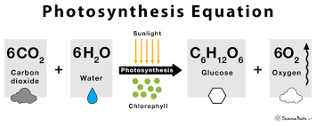
Agent Technology – an inspiration
Massive systems (sun, human body, solar system, country, ) are governed by computing/operations taking place at the minute (tiny) level entities
Atomic level actions in the sun (H↔He)
Molecules
Cells (In the body glucose is burnt and produce energy)
Ants, Bees
These tiny entities are called Agent
Agent technology promote to write small AI programs like agent

Slide 104
Understanding Agent (Robotics)
When you say to a travel agent “I won’t go to a conference in London”
Then a Travel Agent does the following related thing without bothering the client very much:
Flight booking
Hotel reservation
Taxi booking
Conference registration
He may get support from another agent
Upon completing a task with a client, the agent switches to the next client
How can we develop software that mimics agent behavior
‹#›

Slide 105
Exercise
Name FIVE agents that you have seen
Policeman
Layer
CIA Agent
Security officer
Insurance Agent
Travel Agent
Servant
Car/Drone/
Dog
Cat
Mobile Phone
‹#›

Slide 106
Some characteristics of Agents
Situatedness - works in a specific environment
Dog looks after a particular house
The action/presence of Agent is influential to the environment
Act on behalf of a master – agent works for a master
Dog only listens to one master
Autonomous – act with little/no instruction
When a visitor comes a dog starts barking without the master’s order
Consume fewer resources
Food, locations, etc. are minimal (less use of CPU and Memory)
Adaptivity – adjustable to the situation
Initially barking at a person, slowly became friendly with ..
Activate when required, execute, and disappear
When a Sound comes, the dog gets up, barks, no sound/sleeps again
Self-driving car as an Agent
Roads
If an accident happens, the master is responsible
‹#›

Slide 107
Some characteristics of Agents
Reactive - stop ongoing work and attend the master
Barking dog stops when the master calls the dog
Proactive - attending related tasks when there is free time
Dog walks around the house, and garden looks over the wall/gate
Intelligent, Knowledge, Rationality
The dog does not bark at a visitor when a visitor is with the master, but the dog is watchful
It is expected the agents to do the right thing
Able to move
within the its master’s area
Interact or sociability (cooperate, coordinate, negotiate)
Think of an Agent application
for Planning a batch-trip
Location Agent
Transportation
Accommodation
Costing agent
‹#›

Slide 108
Exercise
Considering the following entities as agents, describe features of agent technology.
security officer
Self-driving car
Savant at home
‹#›

Slide 109
Exercise
1.Turing Machine (1936) – computability2.
2. Breaking ENIGMA
3. Paper - Computing Machinery and Intelligence
4. Turing Test
Influential Areas
State/Action/Path/
Goal
State space
OPEN/Closed
Develop a concept map for this section of the module.
G
TT
McCarthy-Princeton-CMU-MIT-Stanford (ES) + CMU (Game/ALVIN)
Minsky-Princeton-MIT (NLP)
Intelligence - Knowledge
Informed (2)
Foundation
Search algorithms
A*
History of AI
Uninformed (6)
Chinese room
Evaluation
Search
AI Techniques
Non-symbolic
BF
IT5421
C
O
T
S
Agent
Knowledge representation
ALVIN AlphaGo
Watson
Google Assistant
GTP
PT
Representation
symbolic
Major Areas
Four schools of thoughts
Techniques
Inference
XCON
DART
DeepB
Pathfinder
Techniques
Application
Logic
Rules
SN
Future
‹#›

Slide 110
Two ways of Intelligence
Logica/analytical
Symbolic
Algorithmic
Formal
ACS
ES (XCON)
ELIZA
TT (Deep Blue)
NLP
Games
Robotics
Knowledge
Turing
Training
Non-Symbolic
Non-Algorithmic
Informal
ML
ES (Watson)
Google Assistant
TT (AlphaGo)
NLP
Games
Robotics
Data
Samuel
‹#›

